Slide 1
Life Expectancy (2014 - 2022)
Across continents and within

Slide 2
Findings

Slide 3
Life Expectancy – the average period a person may expect to live
Lifestyle Factors: diet, activity and substance use (e.g., tobacco or alcohol) and/or abuse.
Socioeconomic Factors: social support, income, education and access to healthcare
Environmental Factors: air and water quality and living conditions
Medical Technology and Advancements
Notes:
Establish with audience the possible reasons for these numbers and which ones to be focused on based on data constraints and plurality of variables

Slide 4
Gross Domestic Product – the total value of goods produced and services provided in a country during one year
Personal Consumption – spending by households on goods and services (the largest component of GDP)
Business Investments – spending by businesses on capital goods (e.g., machinery, equipment, buildings, inventory, etc.)
Government Spending – spending by government on goods and services including salaries for government employees, infrastructure and defense
Net Exports – the difference between exports and imports
Notes:
Connect bullets from last slide to components
Social support, medical technologies and public health measures to Government Spending
Income and general living conditions to Personal Consumption
Overlaps – Medical Technologies and General Living conditions a conjunction of personal, government and business investments
Emphasize that while there are a good bit of factors going into this that also affect life expectancy, the focus needs to be on areas that can be handled. If goal is government expenditures focus on government responsibility to the people. If the goal is to alter investment focus on the interplay between net export, business investments and government spending etc.

Slide 5
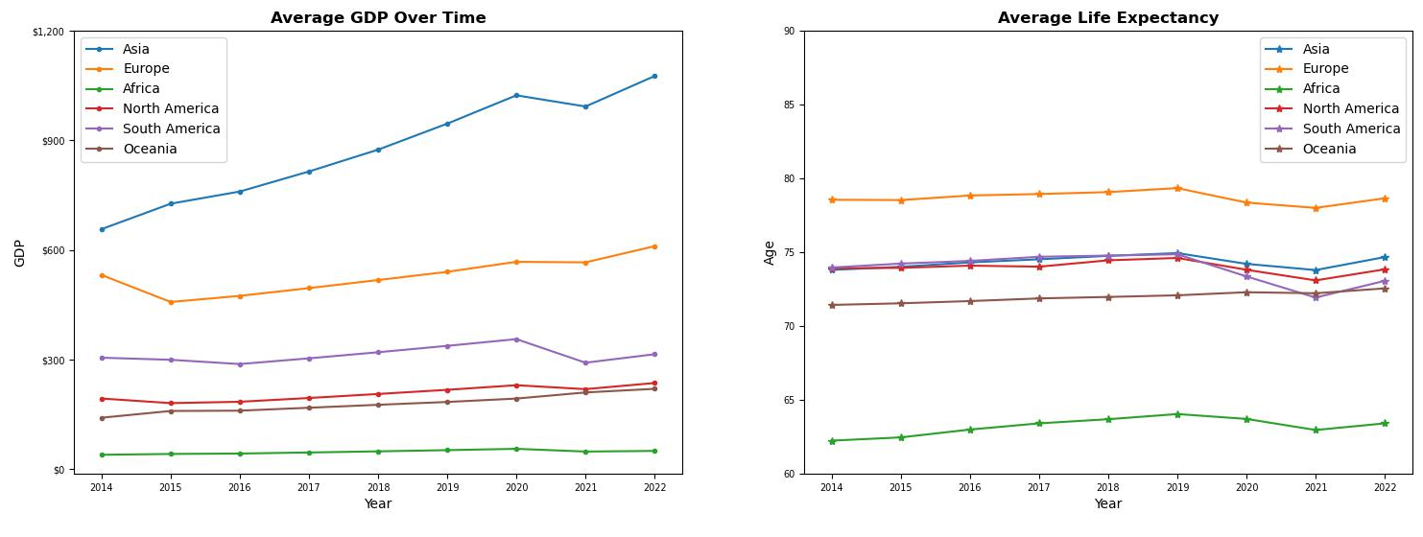
Continent GDP and Life Expectancy Over Time
The highest average life expectancies during this period were in Europe while the highest GDP averages were in Asia

Slide 6
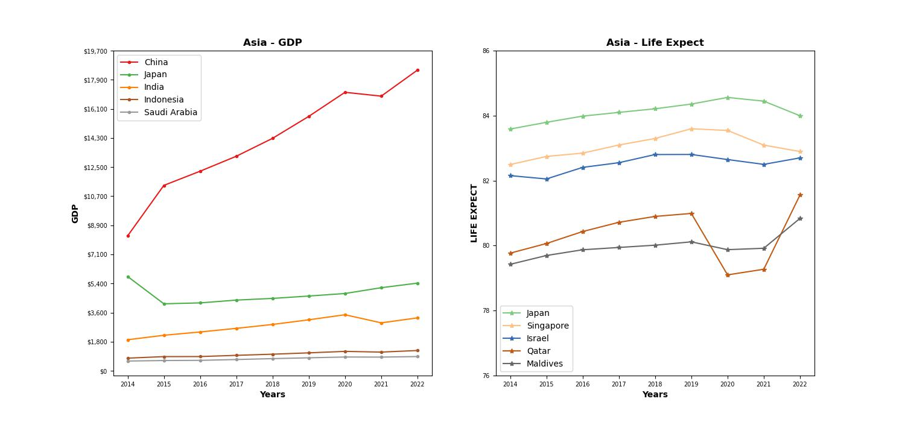
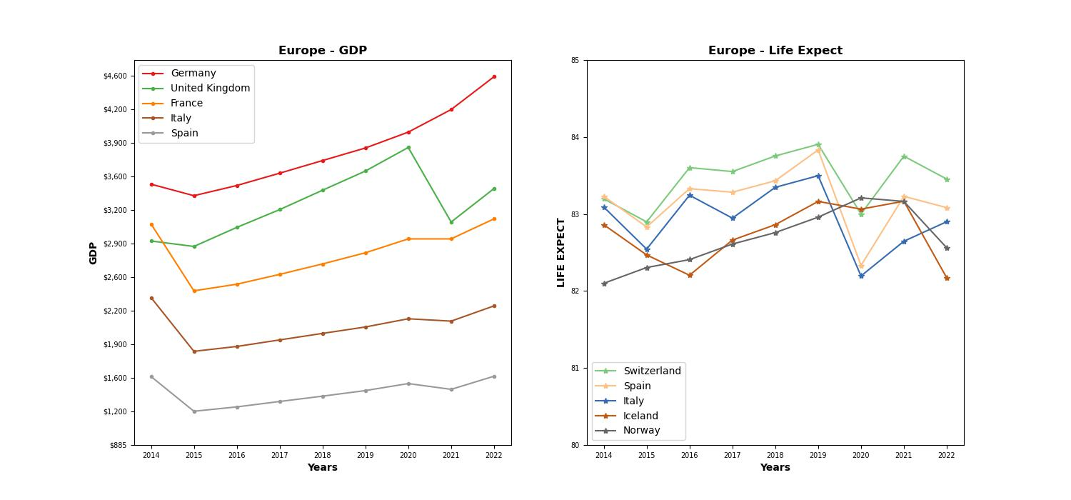
Top 5 Countries for Asia and Europe
Asia
The countries with the highest life expectancy are Japan for Asia and Switzerland for Europe despite the highest GDP’s being in China and Germany
Europe

Slide 7
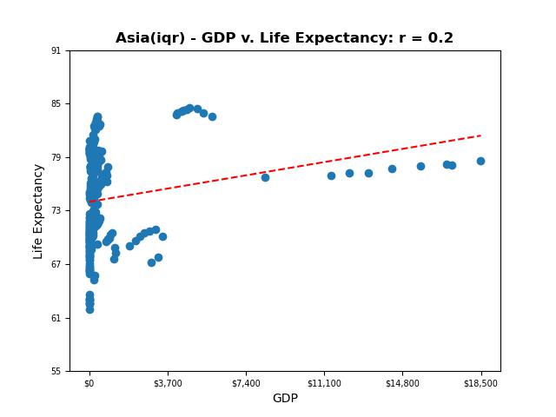
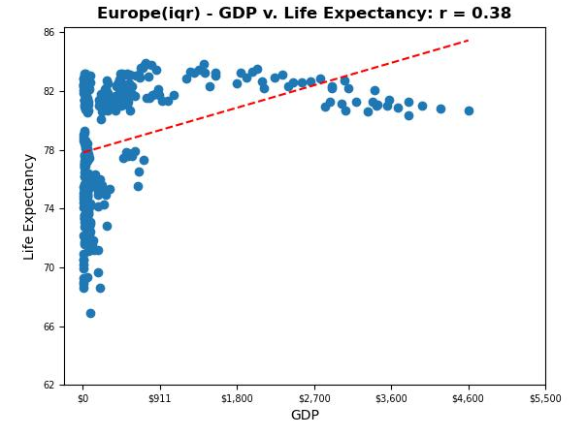
Correlation: GDP v Life Expectancy
Undergoing a correlation analysis of both continents shows relatively weak relationships between GDP and Life Expectancy
Note that the data excludes the top and bottom quartiles to help handle outliers

Slide 8
Why would a relation be expected?
There are some factors within Life Expectancy that can be directly related to GDP factors such as government/business spending and available medical infrastructure
Life Expectancy Factors
GDP Factors
Socioeconomic Factors: social support, income, education and access to healthcare
Medical Technology and Advancements
Government Spending – spending by government on goods and services including salaries for government employees, infrastructure and defense
Business Investments – spending by businesses on capital goods (e.g., machinery, equipment, buildings, inventory, etc.)

Slide 9
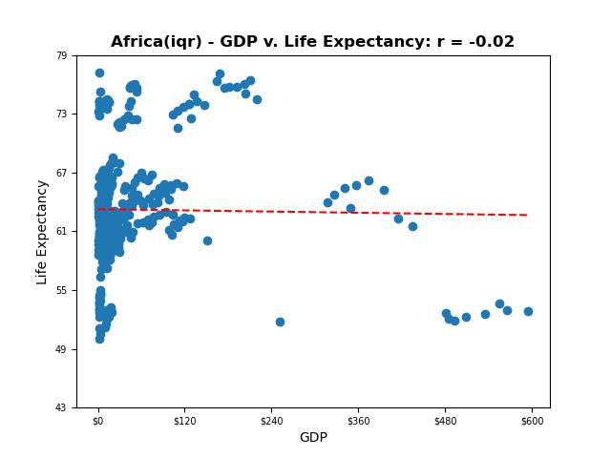
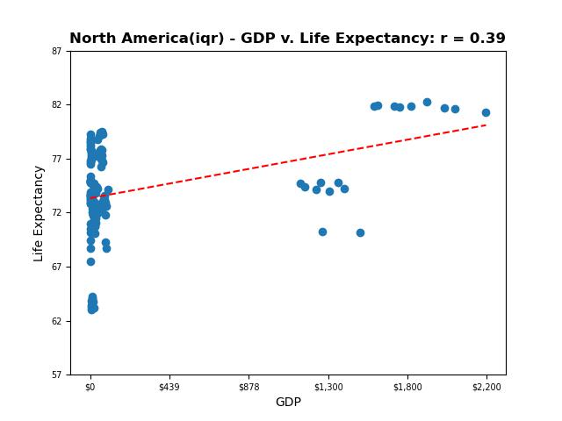
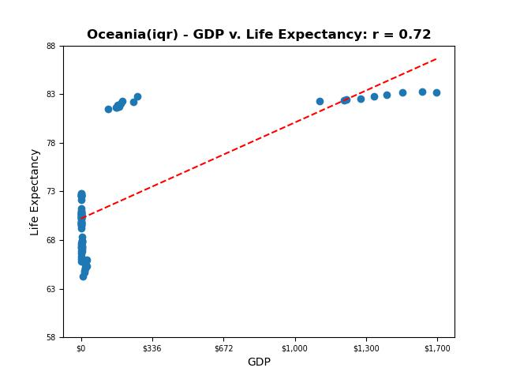
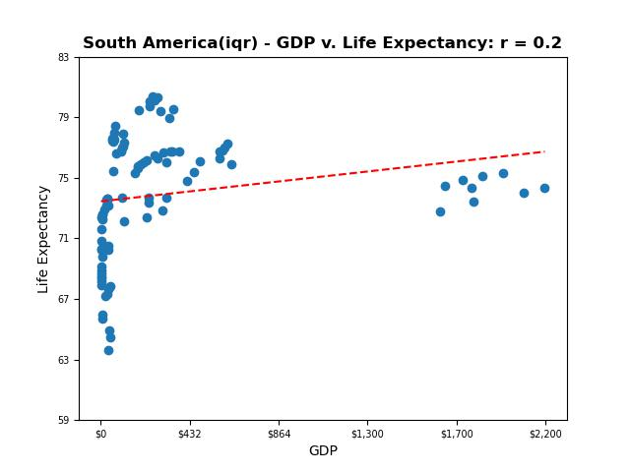
Looking at the correlation across other continents, the relationship varies greatly
Correlations Coefficients:
Oceana: 0.72
North America: 0.39
Europe: 0.38
China: 0.2
South America: 0.2
Africa: -0.02

Slide 10
With larger datasets, the magnitude of the data could muddle the take-away.
Sometimes it’s better to look at a sample. The following are the countries of each continent that have the highest GDP

Slide 11
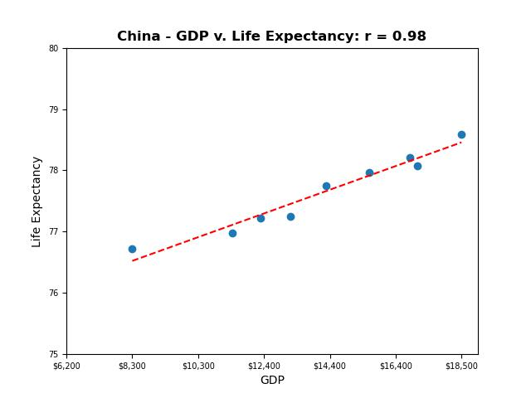
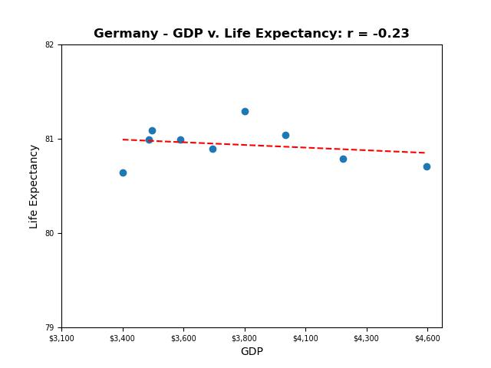
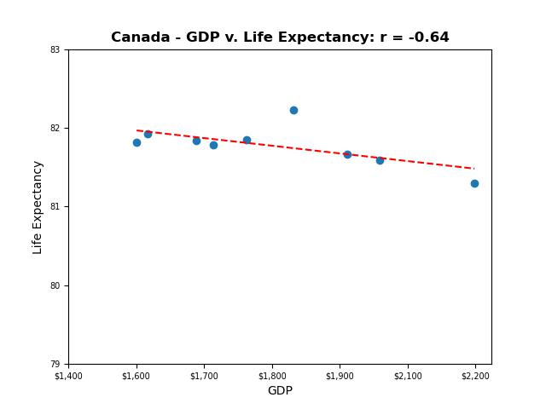
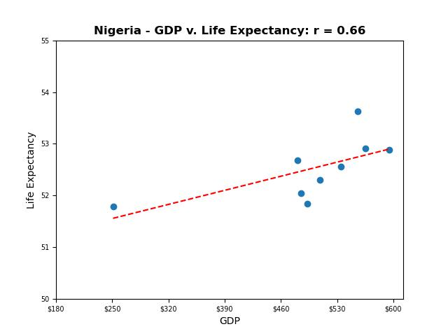
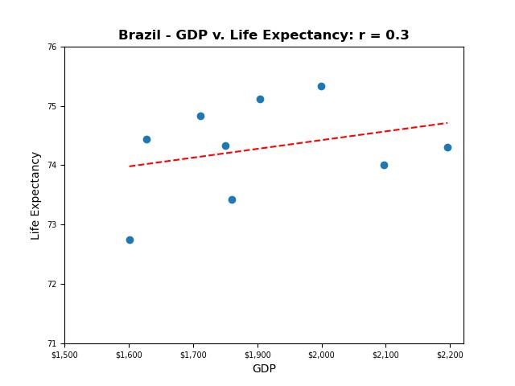
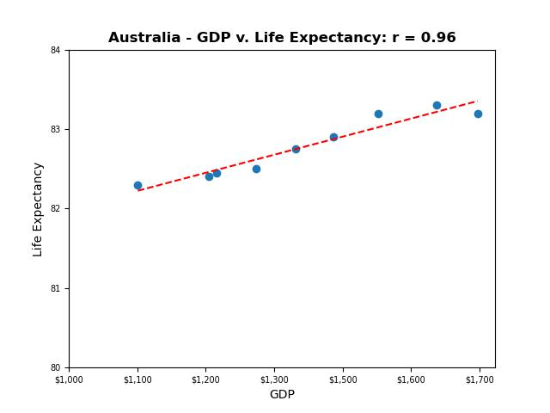

Slide 12
Notice, again that the correlation coefficients are quite diverse.
There are likely other factors to asset allocation within GDP that better predict Life Expectancy

Slide 13
Summary

Slide 14
Alternatives
When looking toward Life Expectancy, it may be more beneficial to look into particular asset allocations (such as medical technology expenditures/stocks) to determine how economics affect how long someone is likely to live.
Namely, predictors of life expectancy are not in the size of the treasury, but ultimately where the contents of the treasury go.

Slide 15

Q & A

Slide 16
Appendix
When looking at other asset allocations, it may be useful to look at the outcomes of these allocations
The dataset on world population health also comes with sets of health expectancy and mortality rates
The following is a correlation heatmap that may determine further areas of interest

Slide 17
